Slide 1

📄 Document Q&A Chatbot using Agentic RAG with MCP
Answering questions using user-uploaded documents (PDF, DOCX, etc.)
Presented by Korlamanda Naga Subhasravani

Slide 2

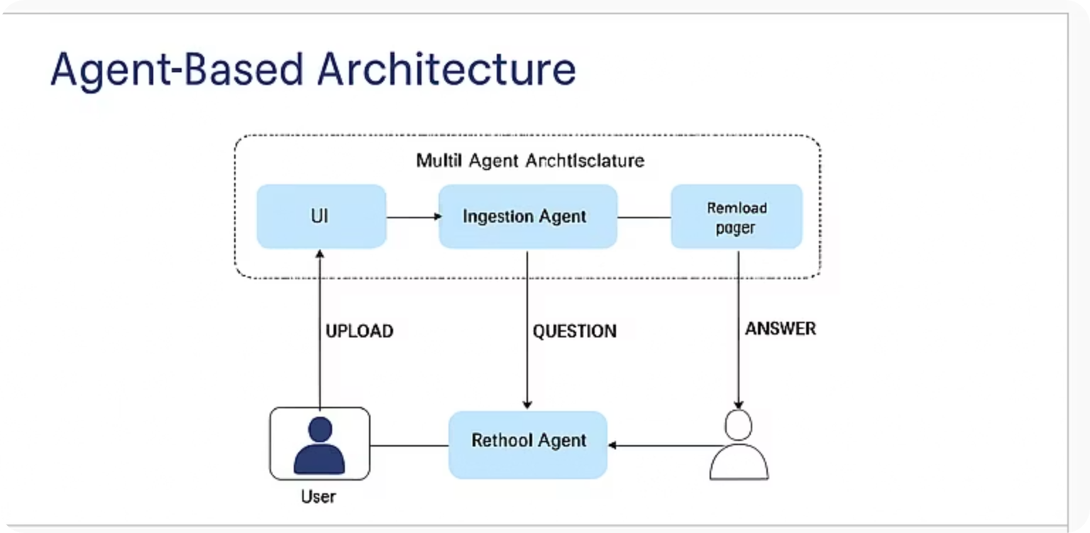



Agent-Based Architecture with MCP Integration
This system uses three specialized agents communicating via the Model Context Protocol (MCP), a structured messaging schema ensuring organized conversation flow. Each message defines sender, receiver, type, trace_id, and payload for traceability and data integrity.
IngestionAgent
RetrievalAgent
Parses uploaded files, splits text into meaningful chunks, and creates embeddings for vector storage.
Queries FAISS vectorstore to find relevant text chunks matching the user's question.
LLMResponseAgent
Combines retrieved context and generates the final answer using a large language model.

Slide 3

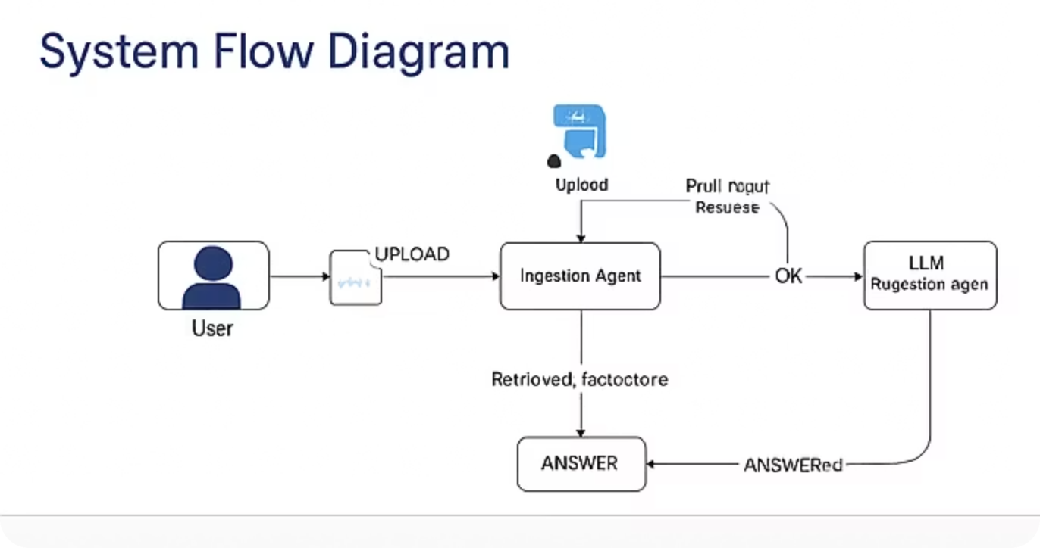
System Flow Diagram with MCP Message Passing
The end-to-end flow manages document ingestion, search, and response generation with seamless agent communication:
User uploads document via UI interface.
UI sends an MCP message to the IngestionAgent for processing.
An in-memory FAISS vectorstore is created to index the document chunks.
User query is sent as MCP message to RetrievalAgent.
RetrievalAgent fetches relevant chunks based on vector similarity.
MCP message with context is forwarded to LLMResponseAgent.
The system returns the final answer on the user interface.

Slide 4
Tech Stack Overview
The chatbot leverages modern and scalable technologies optimized for performance and usability:
Frontend/UI
Streamlit framework with LocalTunnel enables quick development and secure sharing of the app.
Large Language Model
Google Generative AI's Gemini 1.5 Flash provides powerful generation capabilities tailored for conversational AI.
Embeddings
GoogleGenerativeAIEmbeddings (models/embedding-001) create semantic vector representations used in retrieval.
Vector Store
FAISS library efficiently indexes and searches embedded document fragments.
Framework
LangChain orchestrates multi-agent interactions and pipeline coordination.
File Support
Handles popular document formats including PDF, DOCX, and TXT for broad applicability.

Slide 5

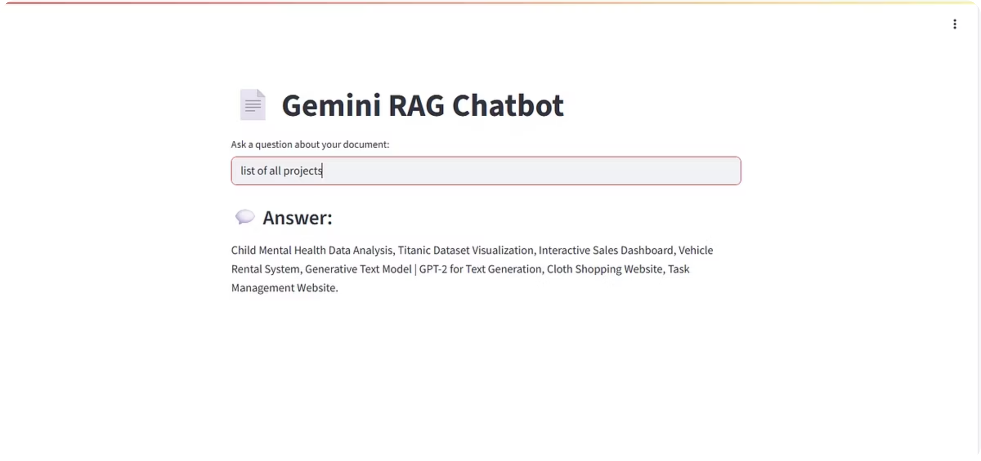
UI Screenshots & Example Questions
The UI features intuitive document upload and question input components. Typical example queries include:
What models are used in the SpamShieldAI project?
Which libraries supported GPT-2 text generation?
Describe feature selection and hyperparameter tuning techniques.
Identify skills demonstrated across the projects.
Distinguish projects that use deep learning versus classical ML.
Confirm which projects leverage Flask or React frontends.
Were LangChain tools employed in any project pipeline?

Slide 6

Challenges & Future Directions
Challenges
Managing large file sizes and chunk limits.
Encountering Gemini model compatibility errors (e.g., 404 on unsupported models).
Handling FAISS deserialization warnings.
Deploying Streamlit apps seamlessly from Colab environment.
Future Enhancements
Enable multi-document upload and querying.
Integrate OCR to handle scanned PDFs.
Implement conversation history persistence for context continuity.
Improve answer reliability by referencing source documents explicitly.

